Slide 1

Lec08 Spatial Analysis
耿瑞霞（嘎嘎）
清华大学公共管理学院
主办单位：清华大学学生学习与发展指导中心、公共管理学院党委研究生工作组
技术支持：清华大学计算社会科学平台
承办单位：公共管理学院研究生会、经济管理学院研究生会、
学生学习与发展指导中心前研工作室、清华大学研究生会

Slide 2



清华大学学生学习与发展指导中心
乐学
清华大学公共管理学院党委研究生工作组
公管声音
清华大学计算社会科学平台

Slide 3
Why Spatial？
空间时间依赖
空间自回归模型
遗漏变量
空间杜宾模型
异质性
空间误差模型
外部性
空间X滞后模型
不确定性
后验概率模型

Slide 4
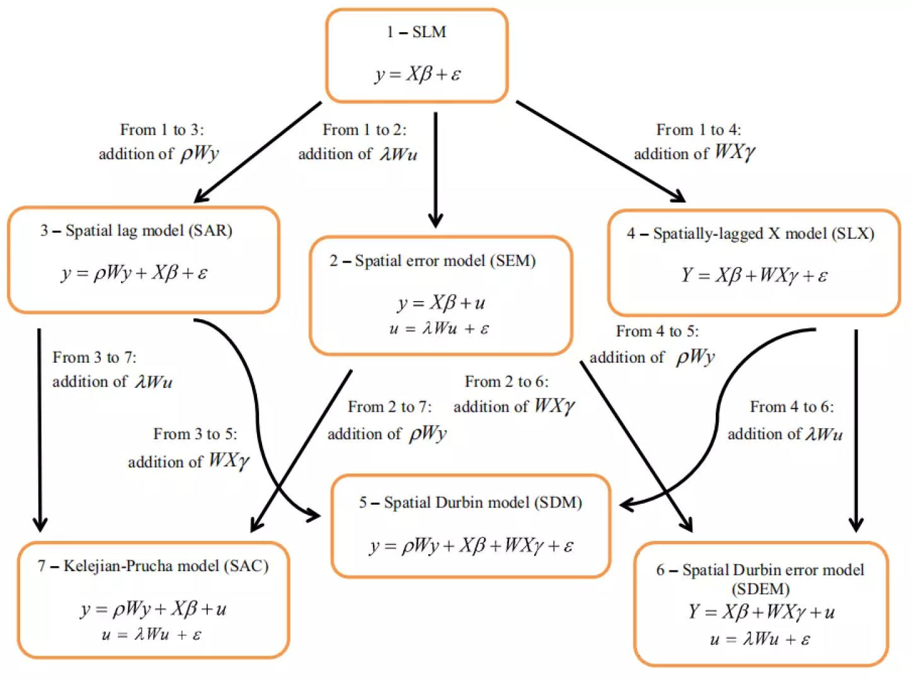
What Spatial？

Slide 5
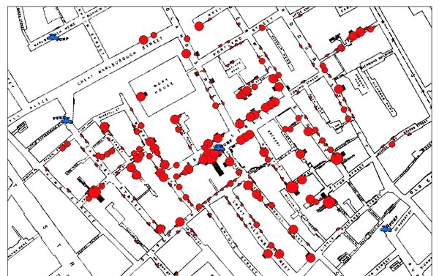
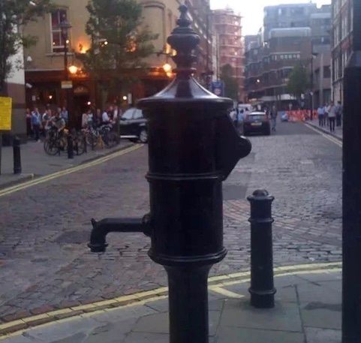
What Spatial：Origin
× Moran (1950)
At the end of the 1840s, a severe cholera epidemic broke out in London
John Snow：air pollution VS water pollution
Disease Mapping

Slide 6
What Spatial： 3 stages
0：1840s
Embryonic period: 1960s -1980s (conception)
Moran (1950)
Tobler (1979) ：Tobler's first law
Evolution period: The 1990s (Models and software)
Anselin & Rey (1991) distinguished the difference between real (Substantial) spatial dependence and Nuisance (Nuisance) spatial dependence
Le Sage (1999) 开发 Web book + Matlab Code
R Packages(2012) spdep/splm/mgcv
Mature period: 21C
Spaital Panel: Lee
The model phase
……

Slide 7
What Spatial：eg.
Outcome
Disease incidence, death rate, income level, employment rate, school enrollment rate
Location
continents and oceans, the right and the left, a single center, multicentric, different types of distributions, different variances
http://maps.gov.bc.ca/ess/sv/imapbc/
Microsoft Silverlight
government preventive measures

Slide 8
When Spatial? Spatial Effects（Anselin，1988）
Spatial Dependence
Substantial：Spatial Interaction Effects
demonstration effect
incentive effect
spillover effect
diffusion effect
feedback effect
clustering behavior
eg. economic factors, the diffusion of innovation, the spillover of technology
SEM(error) = SAC(Autocorrelation)
SLM(Lag) = SAR(Autoregressive)
Spatial Heterogeneity
GWR: Spatial Varying-Coefficient Regression Model

Slide 9
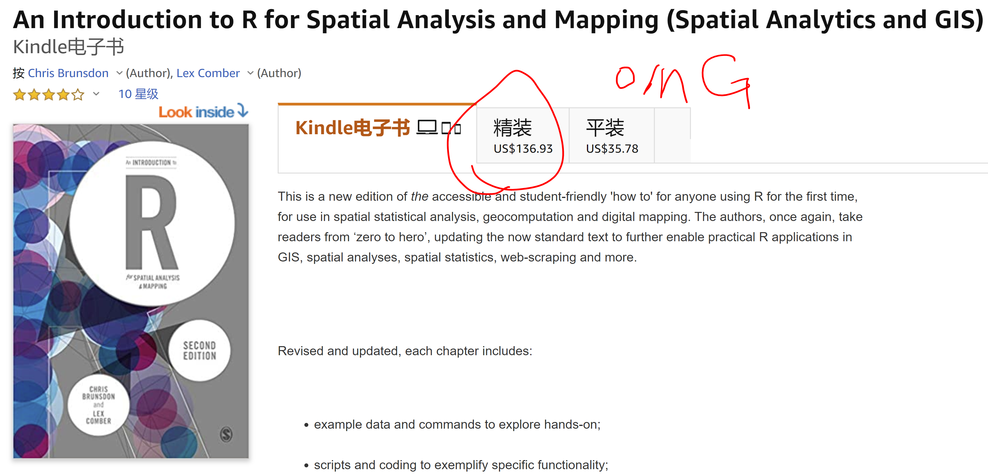

How spatial? book1
https://uk.sagepub.com/en-gb/asi/an-introduction-to-r-for-spatial-analysis-and-mapping/book258267#resources

Slide 10
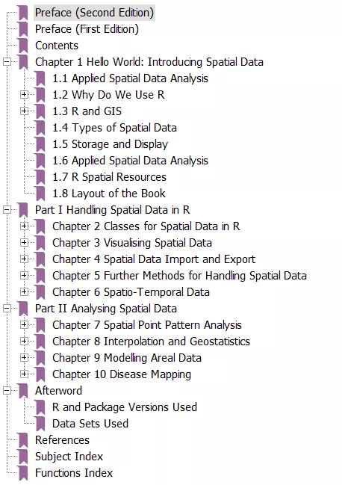
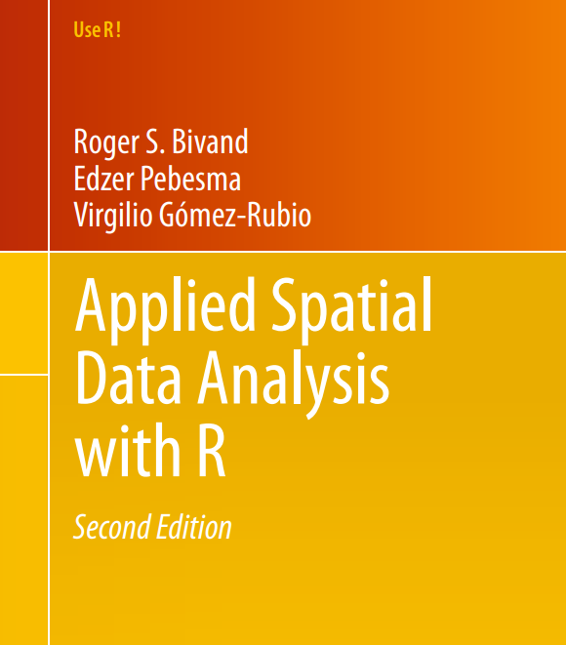
How spatial? book2
Roger S. Bivand
Edzer Pebesma
Virgilio Gómez-Rubio

Slide 11
How spatial? package help
http://www.rdocumentation.org/
https://stackoverflow.com/search?q=spdep

Slide 12
How spatial? Seven steps
1.Spatial Weighting Matrix
2.Spatial Autocorrelation
global Moran’s I——Whether
local Moran‘s I——Where
3.Maps
4.LM-lag/ LM-error test
5.Models:
Spatial autocorrelation test: SLX+SEM(SAC)+SLM(SAR)+SDM+SDEM+…
heterogeneity: GWR
6.Marginal effect
7.DE+IE+TE: feedback effects=DE-Durbin

Slide 13
1.Spatial Weighting Matrix
neighbor
queen point 1
rook 0
Inverse distance
economic distance
based on gravity model
economic distance nesting
threshold and inverse threshold

Slide 14
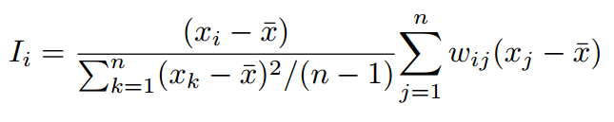
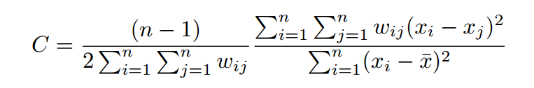
2.Spatial Autocorrelation
Global
moran'I （Moran, 1950)
Geary's C
Getis-Ord global G （Ord & Getis，1995）
Local
Local moran'I
Local Getis-Ord Gi
Gi*

Slide 15
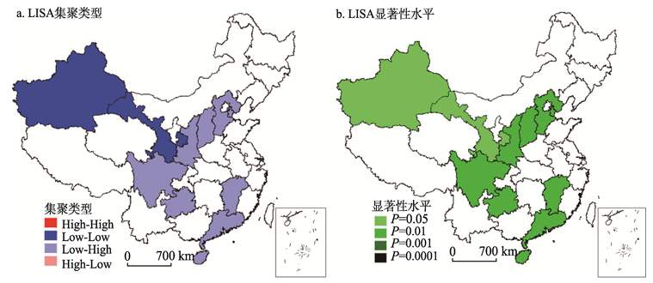
3.Maps

Slide 16
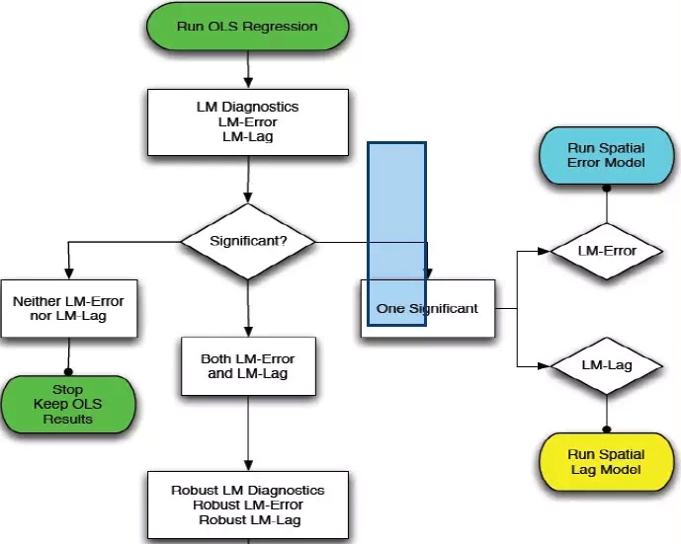
4.LM-lag/ LM-error test

Slide 17
5.Test
1、 Log Likelihood Function LLF
2、Akaike(1974)AICAkaike Information Criterion (1974) AIC
3、 Akaike Information Criterion (1973) Log AIC
4、Schwarz Criterion (1978) SC
5、Schwarz Criterion (1978) Log SC
6、Amemiya Prediction Criterion (1969) FPE
7、 Hannan-Quinn Criterion (1979) HQ
8、Rice Criterion (1984) Rice
9、Shibata Criterion (1981) Shibata
10、Craven-Wahba Generalized Cross Validation (1979) GCV
11、R2

Slide 18
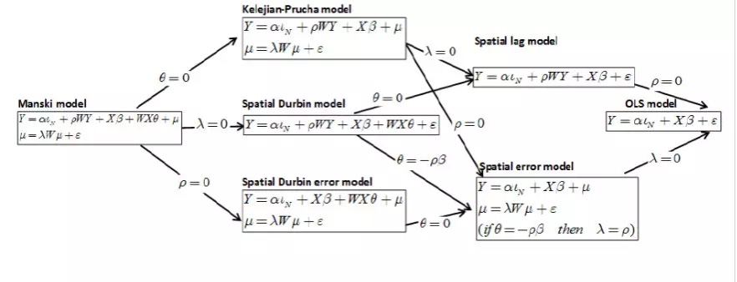
6.Models

Slide 19
Other spatial packages
spsurvey 概率抽样
GeoXp 交互模型
spBayes 蒙特卡洛——马尔科夫链方法（MCMC）单变量和多变量高斯模型
DCluster 计数数据计算空间权重
WeedMap 空间预测
pastecs 时空序列的分解和分析

Slide 20
Other spatial models
Frontiers of Spatial Models
spatial DID
GWR（Geographical Weighted Regression）
GMM spatial error/ lag https://geodacenter.github.io/GeoDaSpace/
Error variance - covariance matrix (STARS/gstat)
Moving average error
Endogenous space lag
spatial prediction
Spatial Dynamic Panel Data Model
probit、 simultaneous equations model
Geoda\Arcgis

Slide 21
Software
Space Stat
S+Spatialstats
Matlab
GIS
R
Geo Da
Arc GIS
Limit: Spatial-temporal analysis
Distributed computing and cloud computing

Slide 22
Interesting
KDnuggets（http://www.kdnuggets.com/ ）
R-bloggers（http://www.r-bloggers.com/ ）
https://plot.ly/r/
FlowingData（https://flowingdata.com/ ）
https://www.kaggle.com/c/titani
eg. Credit card fraud analysis: http://t.cn/R9U62yt

Slide 23
References
1.Baltagi,B.H.,Song,S.H.,Jung B. and Koh, W.(2007) Testing panel data regression models with spatial and serial error correlation. Journal of Econometrics,140,5-51
2.Baltagi,B.H.,Song,S.H and Koh, W.(2003) Testing panel data regression models with spatial error correlation. Journal of Econometrics,117,123-150
3.Millo,G.,Piras,G.(2012) splm:Spatial Panel Data Models in R. Journal of Statistical Software,47(1),1-38.URL http://www.jstatsoft.org/v47/i01/
4.Elhorst, J.P (2003) Specification and estimation of spatial panel data models, International Regional Science Review,26,pages 244-268
5.Elhorst, J.P(2009) Spatial panel data models, In Fisher,M.M. and Getis,A.(eds),Handbook of Applied Spatial Analysis Springer,Berlin
6.Giovanni Millo and Gaetano Carmeci,(2011) “Non-life insurance consumption in Italy: a subregional panel data analysis”, Journal of Geographical Systems,13:273-298
7.Qu Feng and William C. Horrace,(2012)”Alternative Measures of Technical Efficiency :Skew,Bias and Scale”, Journal of Applied Econometrics, Forthcoming.

Slide 24
Sharing： spiders
http://www.mca.gov.cn/article/sj/xzqh/2020/2020/202003301019.html
The code of administrative divisions above county level in the People's Republic of China in February 2020

Slide 25
谢 谢
2020春清华定量俱乐部
主办单位：清华大学学生学习与发展指导中心、公共管理学院党委研究生工作组
技术支持：清华大学计算社会科学平台
承办单位：公共管理学院研究生会、经济管理学院研究生会、
学生学习与发展指导中心前研工作室、清华大学研究生会

